Slide 1
Artificial neural networks
Notes:
https://beta.polleverywhere.com/activities?group_id=-1

Slide 2
Remember

Slide 3


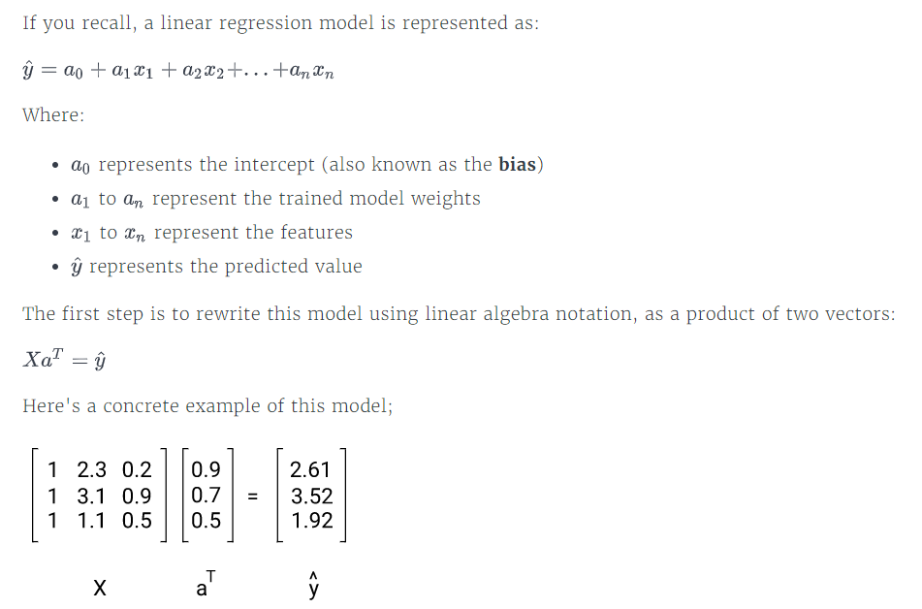
Notes:
Y kapelo is the output of our NN not the actual output

Slide 4
Plan for today
ANN presentation
LAYERS
ACTIVATION FUNCTION
FEEDFORWARD
How do NN learn(Backpropagation)
Code

Slide 5
Artificial Neural Network presentation

Slide 6
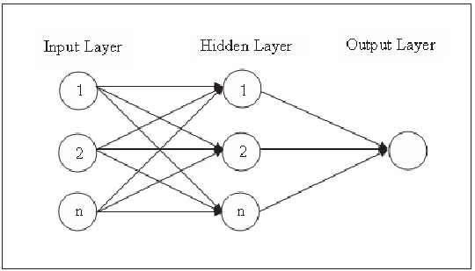
Notes:
EXPLAIN WHAT IS , NODE, INPUT HIDDEN OUTPUT LAYER
SAY ABOUT BIAS
Say that the most simple nn called percepton

Slide 7
Difference in representation

Slide 8
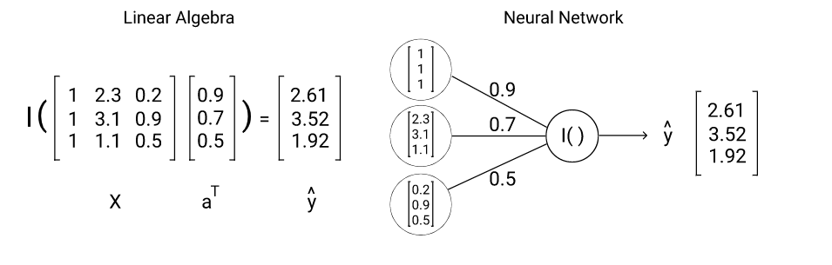
Notes:
How we transmit from linear algebra to NN

Slide 9
Layers
Input layer: Our input nodes, also known as the “input layer”.
Hidden layer: intermediate layers of nodes between the input and output layers called the "hidden layers“.
Output layer: outputs the hypothesis function, known as the "output layer".
Notes:
Go back and show the input layers
Say that the more hidden layers we have the more deep our NN is

Slide 10
Notes:
EXPLAIN THAT θ IS THE NYMBER THE PARAMETERS
Ai WILL BE THE SUM OF
Weight or parameter
Difference between the Θ in NN and the a in linear
Initialization of weights
Not 0 gradient descent will not work
Not all the same value our algorithm will not understand the difference

Slide 11
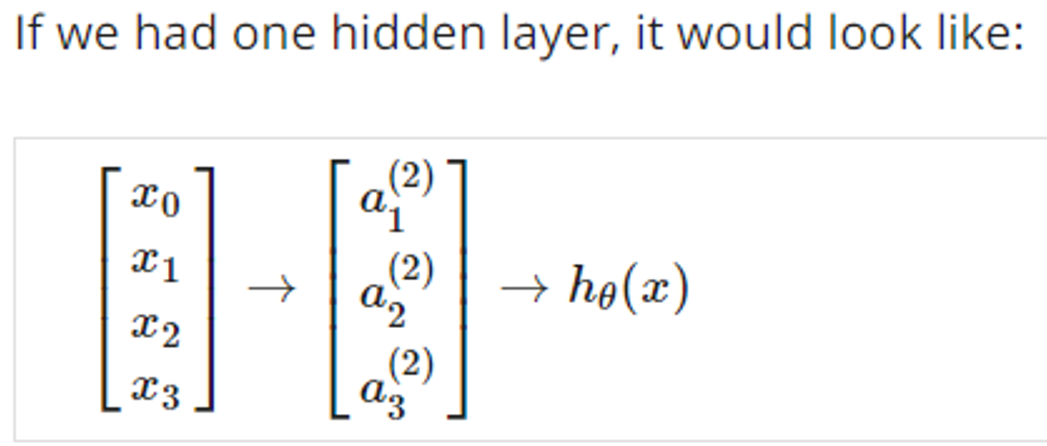
EXERCISE
Notes:
ASK WHAT THE HYPOTHESIS WILL BE AND WHAT THE A1

Slide 12
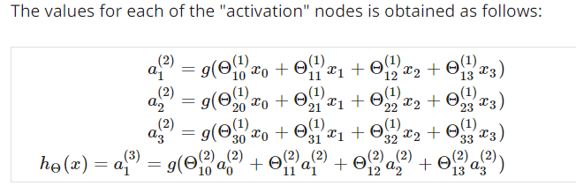
Notes:
Does anyone know what g is ?

Slide 13
Dimension

Slide 14
Activation functions

Slide 15
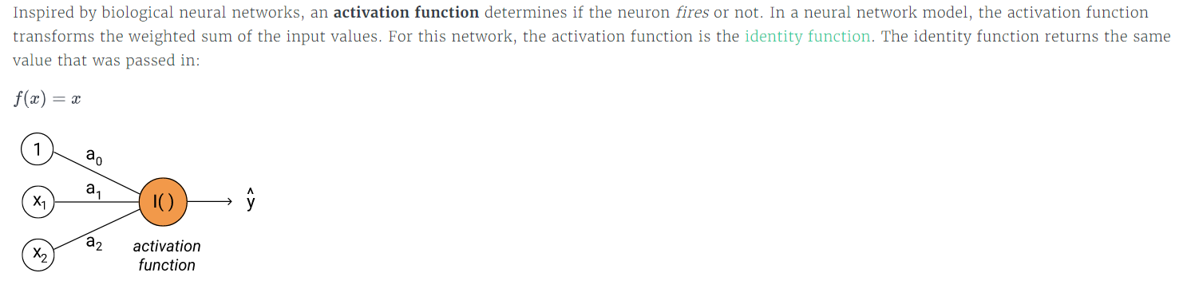
Notes:
Explain what is activation function
When the neural fires
Very useful because it keeps our data simple without losing any of the importance
Example of the house price and no of bedrooms and the area

Slide 16
What activation functions do we have

Slide 17
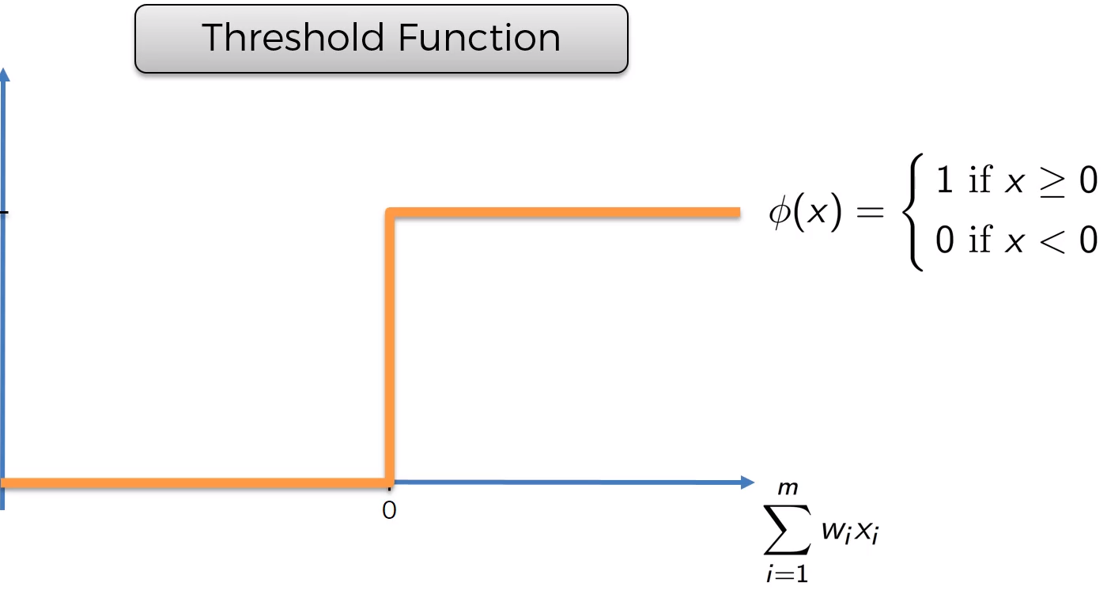
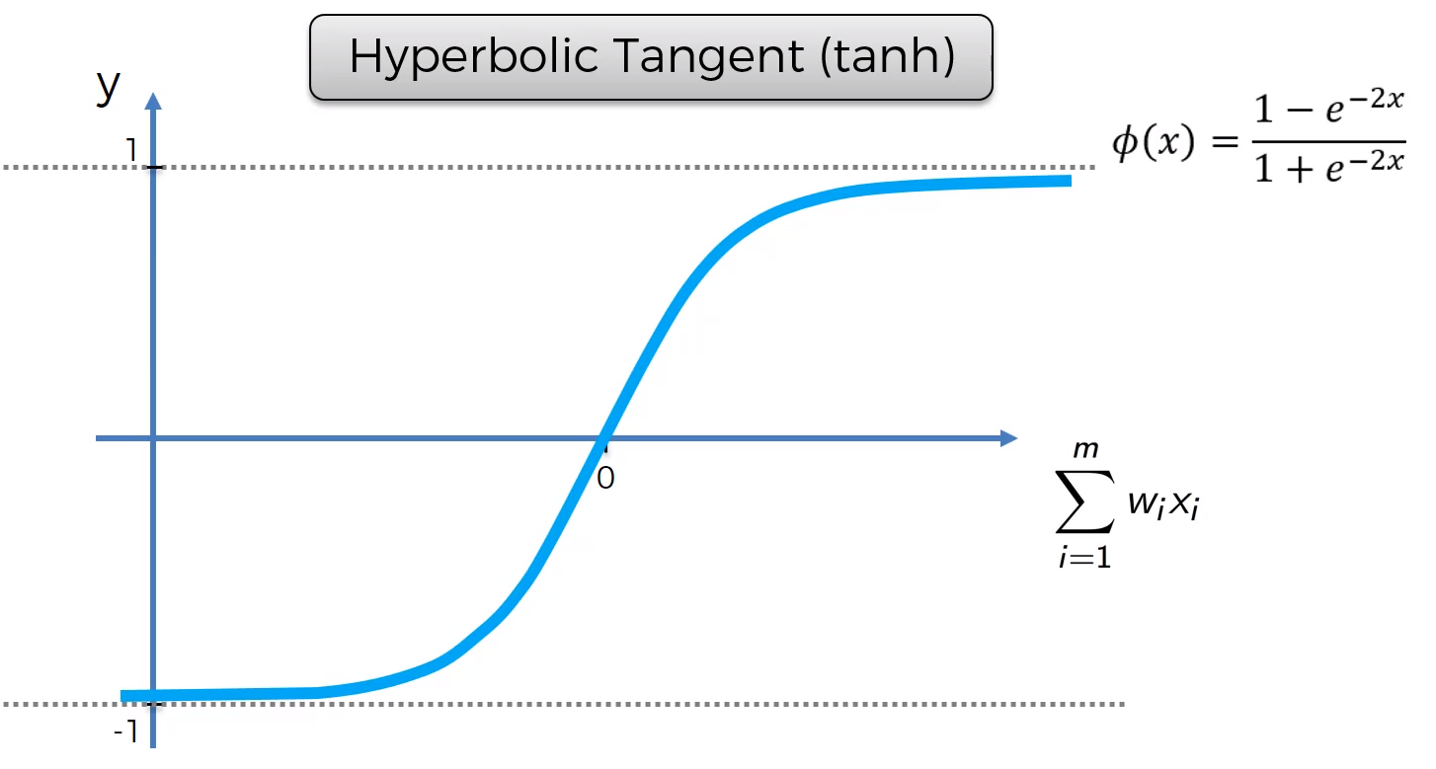
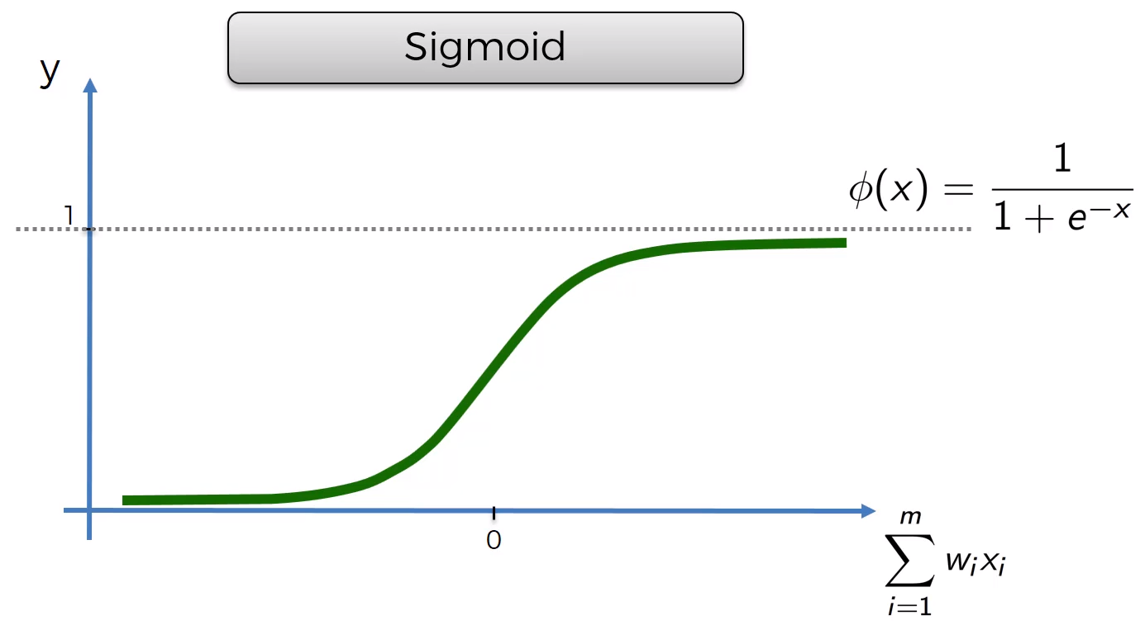
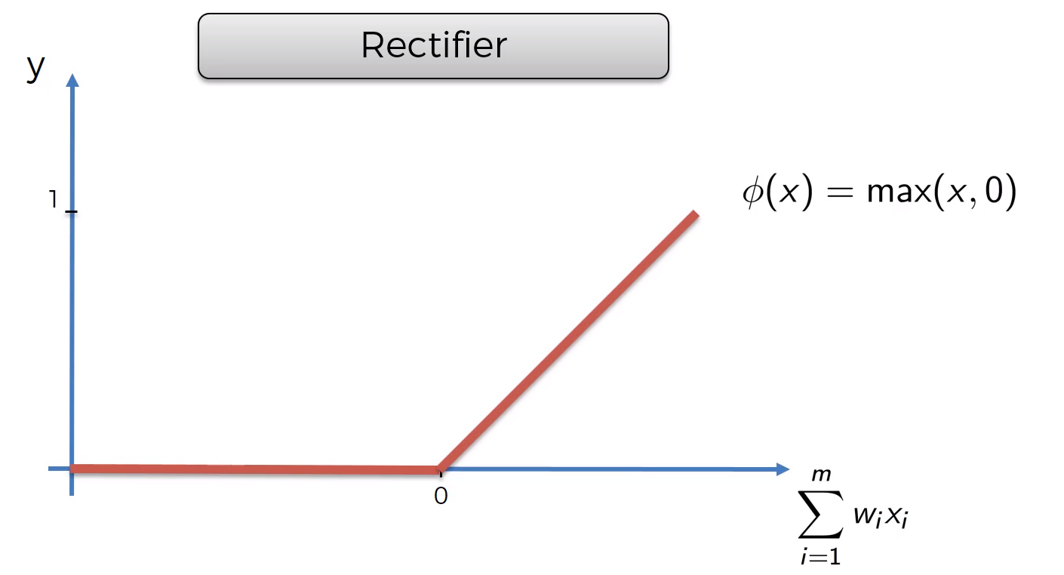

Slide 18
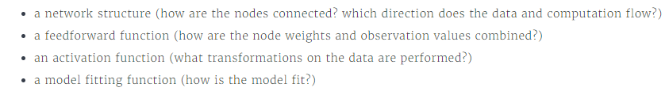
Feedforward

Slide 19
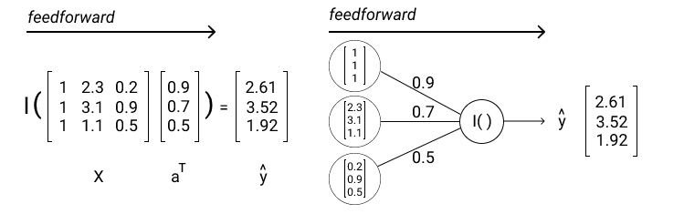
Notes:
Make the calculation on the board
Einai to proto row me to colum

Slide 20
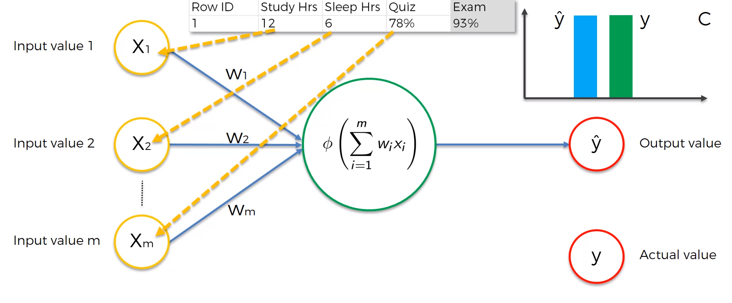
How do neural network learn
Notes:
Let’s see what we have here
Explain the picture
Exampple of a test in class
A graph that shows the actually ouput and our algorithm output the cost function

Slide 21
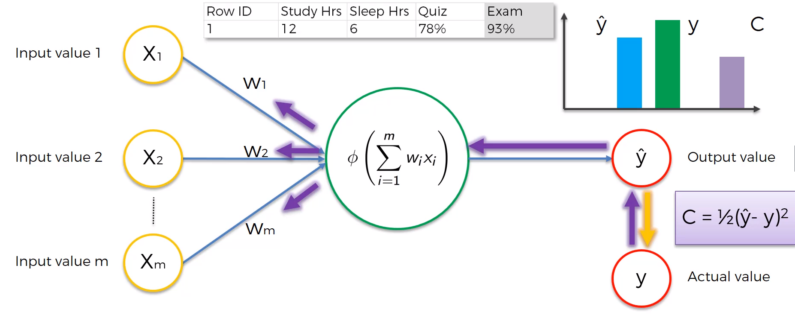
Notes:
Refer to what an epoch is
Explain the backpropagation based on gradient descent and the way that weights are adjust

Slide 22
That was the backpropagation

Slide 23
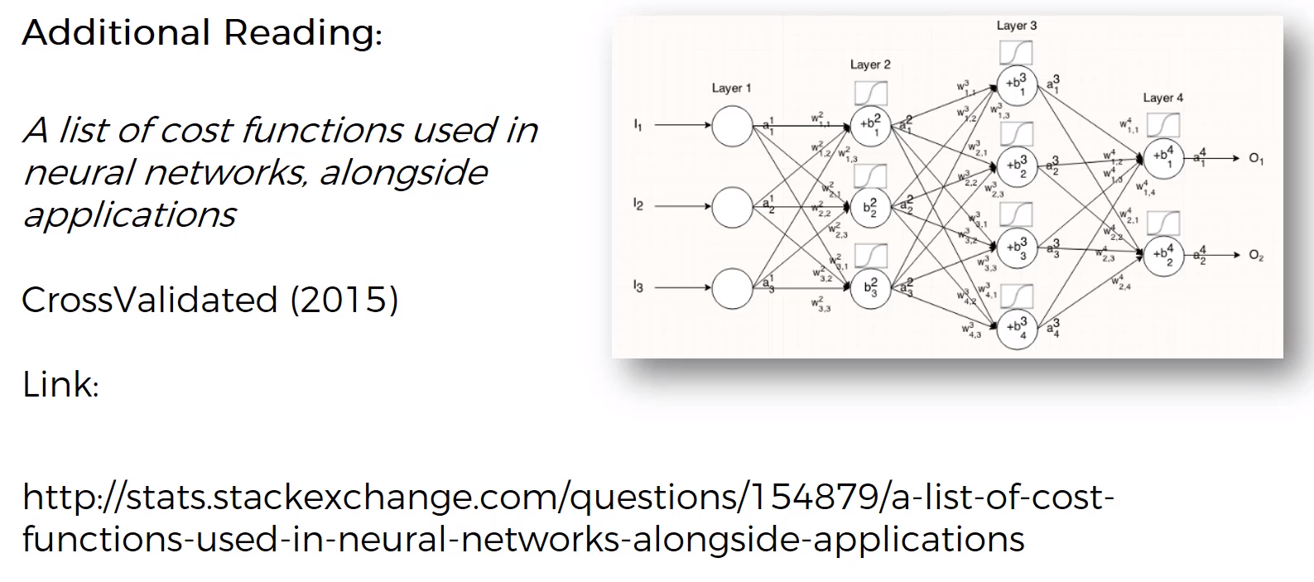

Slide 24
How we adjust the weights
We use the stochastic gradient descent

Slide 25
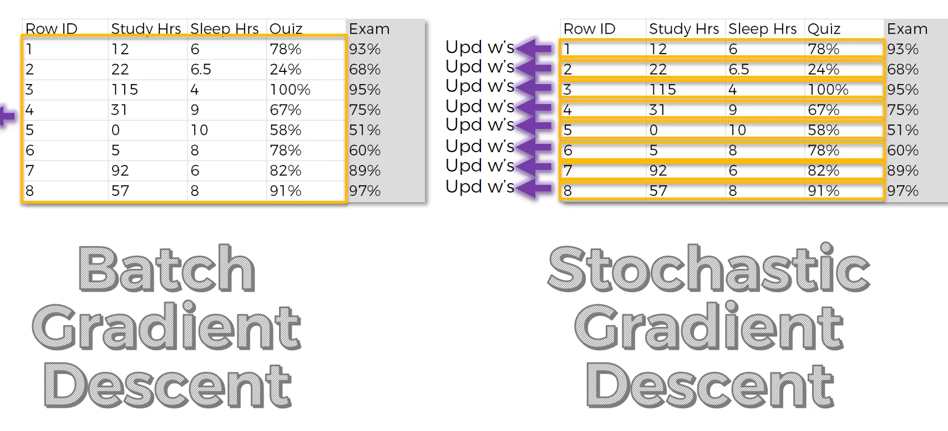

Slide 26
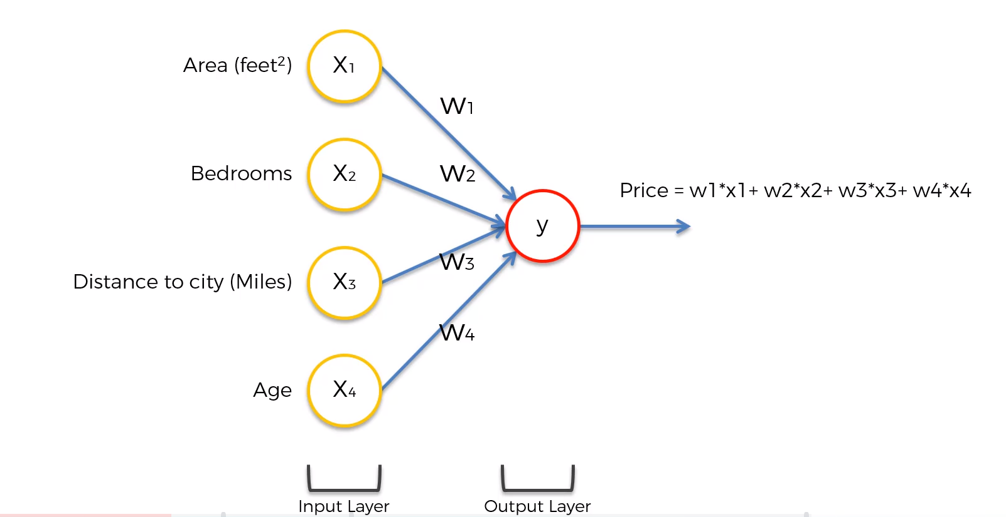
Example

Slide 27
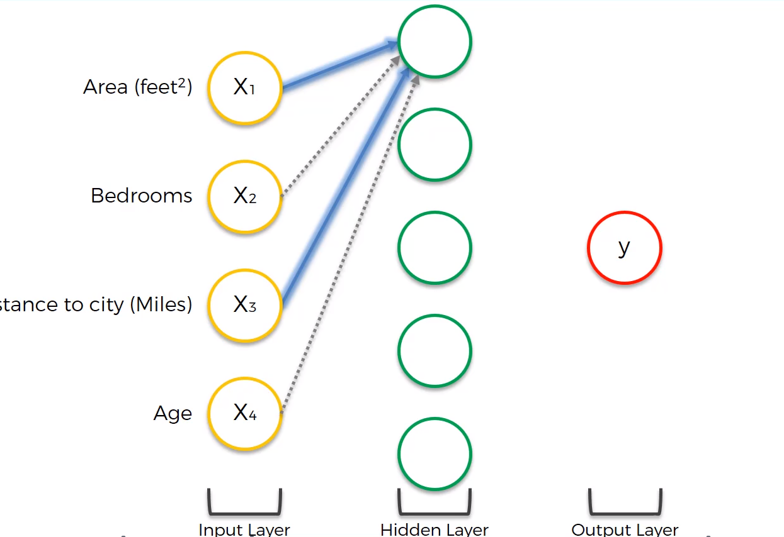
Notes:
Explain that the first layer tales only into consideration the area and the age due to gradient descent
Explain wha is happened during the epochs

Slide 28
Sum up

Slide 29
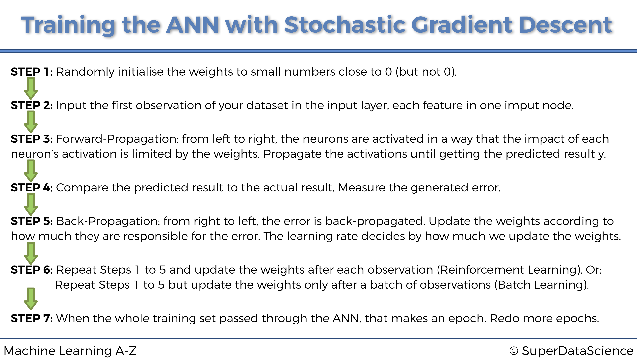

Slide 30
Install Frameworks
Installing TensorFlow:
https://docs.anaconda.com/anaconda/user-guide/tasks/tensorflow/
Installing Keras:
conda install -c conda-forge keras

Slide 31
Let’s code

